Slide 1
COMP814 – Text Mining Information Extraction (NER)

Slide 2
Test Details
The test will be open book and you are free to access any online resource.
The test will be held in the usual lecture room.
You can do the test on the machines in the lecture room or your own laptops.
You will be able to see all the questions in one go and you will be able to go back and review your answers before the submission.
You will be prompted to submit at the end of the allocated one and half hours.
Your test score will be available afterwards.

Slide 3
Test format.
The test will be done online via Canvas.
The link will be available under assessments. at 6.15pm
Each student will have different variations of the test from question bank.
Some of the types of questions will be:
Multichoice
Multi answer
Fill in the blank
Matching
ordering

Slide 4
Named Entity Recognition and Classification
<PER>Mr John Minto </PER> taught COMP814 in <DATE>semester 2 2023</DATE>.
<PER>Mr John Minto </PER> also stood for the elections in <LOC>Auckland</LOC>.
<ORG>Fisher and Pykal </ORG> bought <ORG>Haier</ORG>.
Identify mentions in text and classify them into a predefined set of categories of interest:
Person Names: Mr John Minto
Organizations: Fisher and Pykal, Haier
Locations: Auckland
Date and time expressions: semester 2
E-mail: mkg@gmail.com
Web address: www.elena.co.nz
Names of drugs: paracetamol
Names of ships: Queen Marry
Bibliographic references:
…

Slide 5

Knowledge NER vs. Learning NER - generic
Knowledge Engineering
+ very precise (hand-coded rules)
+ small amount of training data
- expensive development & test cycle
- domain dependent
changes over time are hard to maintain
Learning Systems
+ higher recall
+ no need to develop grammars
+ developers do not need to be experts
+ annotations are cheap (er)
require lots of training data

Slide 6
Rule Based NER (1)
Create regular expressions to extract:
Telephone number
E-mail
Capitalized names

Slide 7
Rule Based NER (1)
Regular expressions provide a flexible way to match strings of text, such as particular characters, words, or patterns of characters
Suppose you are looking for a word that:
starts with a capital letter “P”
is the first word on a line
the second letter is a lower case letter
is exactly three letters long
the third letter is a vowel
the regular expression would be “^P[a-z][aeiou]” where
^ - indicates the beginning of the string
[a-z] – any letter in range a to z
[aeiou] – any vowel
Notes:
Create regular expressions: a set of pattern matching rules encoded in a string according to certain syntax rules.

Slide 8
Perl RegEx
\w (word char) any alpha-numeric
\d (digit char) any digit
\s (space char) any whitespace
. (wildcard) anything
\b word boundary
^ beginning of string
$ end of string
? For 0 or 1 occurrences
+ for 1 or more occurrences
specific range of number of occurrences: {min,max}.
A{1,5} One to five A’s.
A{5,} Five or more A’s
A{5} Exactly five A’s

Slide 9
Rule Based NER (1)
Create regular expressions to extract:
Telephone number
E-mail
Capitalized names
blocks of digits separated by hyphens
RegEx = (\d+\-)+\d+

Slide 10
Rule Based NER (1)
Create regular expressions to extract:
Telephone number
E-mail
Capitalized names
blocks of digits separated by hyphens
RegEx = (\d+\-)+\d+
matches valid phone numbers like 900-865-1125 and 725-1234
incorrectly extracts social security numbers 123-45-6789
fails to identify numbers like 800.865.1125 and (800)865-CARE
Improved RegEx = (\d{3}[-.\ ()]){1,2}[\dA-Z]{4}

Slide 11
Rule Based NER (2)
Create rules to extract locations
Capitalized word + {city, center, river} indicates location
Ex. New Zealand
Auckland city
Capitalized word + {street, boulevard, avenue} indicates location
Ex. Queen Street

Slide 12
Rule Based NER (3)
Use context patterns
[PERSON] earned [MONEY]
Eg. Frank earned $20
[PERSON] joined [ORGANIZATION]
Eg. Sam joined IBM
[PERSON],[JOBTITLE]
Ex. Mary, the teacher
still not so simple:
[PERSON|ORGANIZATION] fly to [LOCATION|PERSON|EVENT]
Eg. Jerry flew to Japan
Sarah flies to the party
Delta flies to Europe

Slide 13
Why simple things would not work?
Capitalization is a strong indicator for capturing proper names, but it can be tricky:
first word of a sentence is capitalized
sometimes titles in web pages are all capitalized
nested named entities contain non-capital words
Auckland University of Technology is an Organization
all nouns in German are capitalized
Tweets/Micro-bloggs have “loose” capitalization

Slide 14
Why simple things would not work?
No lexicon contains all existing proper names.
New proper names constantly emerge
movie titles
books
singers
restaurants
etc.

Slide 15
Why simple things would not work?
The same entity can have multiple variants of the same proper name
Prime Minister
Labour Party Leader
Arden
Proper names are ambiguous
Jordan the person vs. Jordan the location
JFK the person vs. JFK the airport
May the person vs. May the month
Jacinda Arden

Slide 16
Learning Systems
Supervised learning
labeled training examples
methods: Hidden Markov Models, k-Nearest Neighbors, Decision Trees, AdaBoost, SVM, NN…
example: NE recognition, POS tagging, Parsing
Unsupervised learning
labels must be automatically discovered
method: clustering
example: NE disambiguation, text classification

Slide 17
Learning System
Semi-supervised learning
small percentage of training examples are labeled, the rest is unlabeled
methods: bootstrapping, active learning, co-training, self-training
example: NE recognition, POS tagging, Parsing, …

Slide 18
k Nearest Neighbor - Recap
Learning is just storing the representations of the training examples.
Testing instance xp:
compute similarity between xp and all training examples
take vote among xp k nearest neighbours
assign xp with the category of the most similar example in T

Slide 19
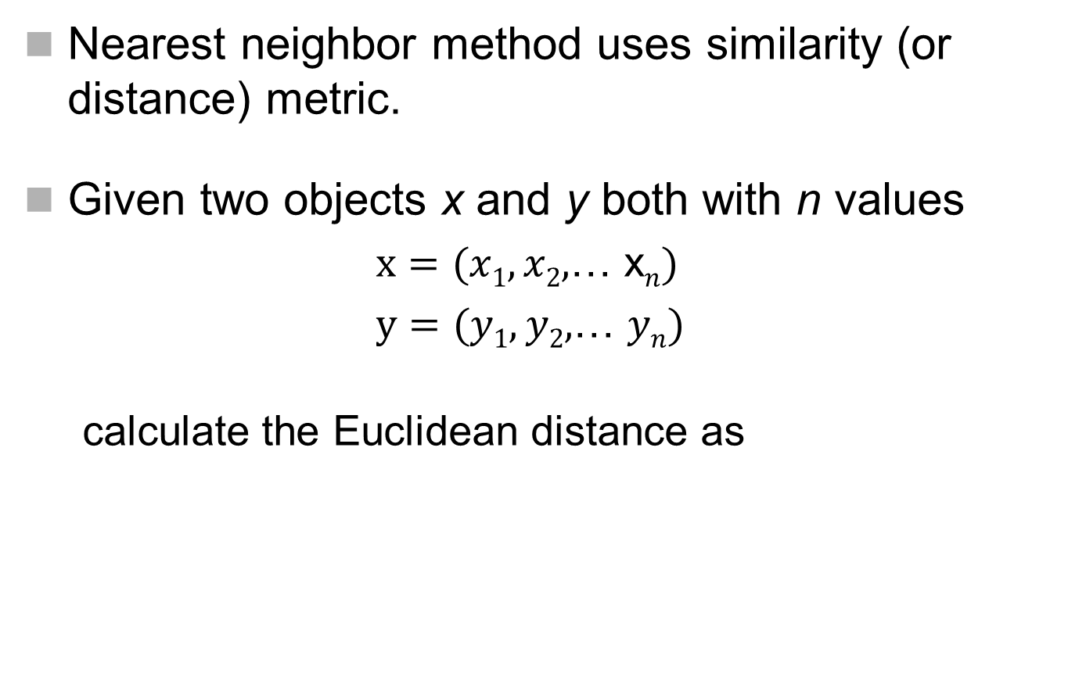
Distance measures
Nearest neighbor method uses similarity (or distance) metric.
Given two objects x and y both with n values
$x=(x1,x2,$… x$n)$
$y=(y1,y2,$… $yn)$
calculate the Euclidean distance as

Slide 20
An Example
 | isPersonName | isCapitalized | isLiving | IsPolitician
John Key(JK) | 1 | 1 | 1 | 1
National Party(NP) | 0 | 1 | 0 | 0
judith collins(JC) | 1 | 0 | 1 | 1
Phil Coye(PC) | 1 | 1 | 1 | 1
Euclidean distance:

Slide 21
1-Nearest Neighbor

Slide 22
3-Nearest Neighbor
choose the
category of the
closer neighbor
(can be erroneous
due to noise)
choose the
category of the
majority of the
neighbors

Slide 23
5-Nearest Neighbor
the value of k is typically odd to avoid ties

Slide 24
k Nearest Neighbours
Pros
+ robust
+ simple
+ training is very fast (storing examples)
Cons
- depends on similarity measure & k-NNs
easily fooled by irrelevant attributes
computationally expensive

Slide 25
Decision Trees
The classifier has a tree structure, where each node is either:
a leaf node which indicates the value of the target attribute (class) of examples
a decision node which specifies some test to be carried out on a single attribute-value, with one branch and sub-tree for each possible outcome of the test
An instance xp is classified by starting at the root of the tree and moving through it until a leaf node is reached, which provides the classification of the instance

Slide 26
An Example
 | isPersonName | isCapitalized | isLiving | X is PersonName?
profession | 0 | 0 | 0 | NO
John Key | 1 | 1 | 1 | YES
National Party | 0 | 1 | 0 | NO
Judith Collins | 1 | 1 | 0 | NO
Each internal node tests an attribute
isCapitalized
1
0
isPersonName
NO
Each branch corresponds to an
attribute value node
1
0
isLiving
NO
Each leaf node assigns a
classification
YES
NO

Slide 27
Building Decision Trees
Select which attribute to test at each node in the tree.
The goal is to select the attribute that is most useful for classifying examples.
Top-down, greedy search through the space of possible decision trees. It picks the best attribute and never looks back to reconsider earlier choices.

Slide 28
Decision Trees
Pros
+ generate understandable rules
+ provide a clear indication of which features are most important for classification
Cons
error prone in multi-class classification and small number of training examples
expensive to train due to pruning

Slide 29
Features for NE Detection (1)
Adam Smith works for ibm in London.
Contextual
current word W0
words around W0 in [-3,…,+3] window

Slide 30
Features for NE Detection (2)
Adam Smith works for IBM in London.
Ortographic
initial-caps
all-caps

Slide 31
Features for NE Detection (3)
Orthographic (binary and not mutually exclusive)
initial-caps all-caps all-digits
roman-number contains-dots contains-hyphen
acronym lonely-initial punctuation-mark
single-char functional-word* URL
Word-Type Patterns:
functional lowercased quote
capitalized punctuation mark other
Left Predictions
the tag predicted in the current classification for W-3, W-2, W-1
Part-of-speech tag
Functional Words
*
The more useful features you incorporate, the more powerful your learner gets

Slide 32
Features for NE Classificaton (4)
Contextual
current word W0
words around W0 in [-3,…,+3] window
Part-of-speech tag (when available)
Bag-of-Words
words in [-5,…,+5] window
Trigger words
for person (Mr, Miss, Dr, PhD)
for location (city, street)
for organization (Ltd., Co.)
Gazetteers
geographical
first name
surname
company names

Slide 33
Machine Learning NER
Adam_B Smith_I works_O for_O IBM_B ,_O London_B ._O
Adam Smith works for IBM , London .
NED(Named Entity Detection)
Identify named entities using BIO tags
B beginning of an entity
I continues the entity
O word outside the entity

Slide 34
Machine Learning NER
Adam_B-PER Smith_I-PER works_O for_O IBM_B-ORG ,_O London_B-LOC ._O
NED: Identify named entities using BIO tags
B beginning of an entity
I continues the entity
O word outside the entity
NEC: Classify into a predefined set of categories
Person names
Organizations (companies, governmental organizations, etc.)
Locations (cities, countries, etc.)
Miscellaneous (movie titles, sport events, etc.)

Slide 35
United States presidential election of 2008, scheduled for Tuesday November 4, 2008, will be the 56th consecutive quadernnial United States presidential election and will select the President and the Vice President of the United States. The Republican Party has chosen John McCain, the senior United States Senator from Arizona as its nominee; the Democratic Party has chosen Barak Obama, the junior United States Senator from Illinois, as its nominee.
United,0,1,0,0,1,ed,ted,Un,Uni,1,0,1,1,1,null,null,null,States,presidential,election,1,1,1,0,0
Named Entity Detection
TRAIN DATA
Learning Algorithm
Trained Machine
TEST DATA
answer
supervised
United_B States_I presidential_O election_O of_O 2008_O ,_O scheduled_O for_O Tuesday_O November_O 4_O ,_O 2008_O ,_O will_O be_O the_O 56th_O consecutive_O quadernnial_O United_B States_I presidential_O election_O and_O will_O select_O the_O President_B and_O the_O Vice_B President_I of_I the_I United_I States_I. The_O Republican_B Party_I has_O chosen_O John_B McCain_I ,_O the_O senior_O United_B
United,null,null,null,States,presidential,election,1,1,1,1,0,1,0,0,1,1,1,1,1,0,1,0,1,1,ed,ted,Uni,Un
Named Entity Classification
Learning Algorithm
Trained Machine
TRAIN DATA
TEST DATA
answer
supervised
United_B-LOC States_I-LOC presidential_O election_O of_O 2008_O ,_O scheduled_O for_O Tuesday_O November_O 4_O ,_O 2008_O ,_O will_O be_O the_O 56th_O consecutive_O quadernnial_O United_B-LOC States_I-LOC presidential_O election_O and_O will_O select_O the_O President_B-PER and_O the_O Vice_B-PER President_I-PER of_I-PER the_I-PER United_I-PER States_I-PER. The_O Republican_B-ORG Party_I-ORG has_O chosen_O John_B-PER McCain_I-PER ,_O the_O senior_O United_B-PER States_I-PER Senator_I-PER from_O Arizona_B-LOC as_O its_O

Slide 36
Results for NE Detection
Carreras et al.,2002 | Precision | Recall | F-score
BIO dev. | 92.45 | 90.88 | 91.66
CoNLL-2002 Spanish Evaluation Data
Data sets | #tokens | #NEs
Train | 264,715 | 18,794
Validation | 52,923 | 4,351
Test | 51,533 | 3,558
Evaluation Measures

Slide 37
Demo Code

